Slide 1

Exploratory Data Analysis of Global Terrorism Database (GTD)
Under the guidance of
Mr. Rushi KumaR
Presented by
Shruti Manasi (21MDT0049)
Vishal Rao (21MDT0016)
Ritika Tiwari (21MDT0060)
Master of Science Data Science
Vellore Institute of Technology, Vellore, Tamil Nadu
29-05-2022
School of Advanced Sciences (S.A.S.)

Slide 2
Introduction
Objective
Develop understanding of the state of global terrorism since 2010 through exploratory data analysis on GTD, and simultaneously improving our analysing skills.
Motivation
Despite numerous developments over the years, terrorism remains a global agitation across the world. It is, thus, imminent to get a factual and visual understanding of how various attributes escalate or plunge terrorist attacks and their repercussions. Results from analyses as ours shall enable organizations and individuals to improve awareness of the severity of global terrorism, and also provide a reliable reference for counterterrorism initiatives.
29-05-2022
School of Advanced Sciences (S.A.S.)

Slide 3
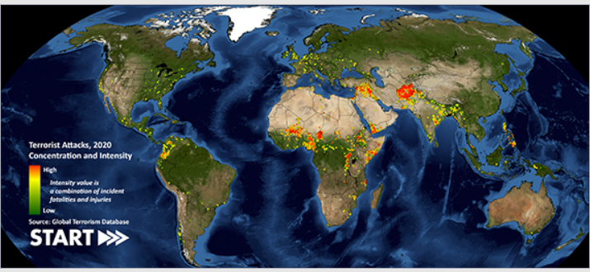
Background
Terrorism in any form is a serious threat to global security. In order to increase understanding of the impact terrorism has on the world, the Study of Terrorism And Responses to Terrorism (START) of the United States has released the Global terrorism Database(GTD).
29-05-2022
School of Advanced Sciences (S.A.S.)

Slide 4
Background
In this project, exploratory data analysis (EDA) is conducted on GTD by the project team. The analysis seeks to address various questions posed by the team through graphical and non-graphical means. Beginning with transforming GTD into a constructive dataset the team progresses through every step of EDA including treatment of missing values to finally produce visualizations that help make sense of the data available. The analysis is concluded by summarizing several pieces of information into an insightful set of results.
Following goals were set to accomplish in the beginning of the analysis:
Transform the original database into a dataset of relevant attributes
Treat the missing values present in the dataset prior the analysis
Produce and interpret visualization to find answers to the set of questions posed by the team
29-05-2022
School of Advanced Sciences (S.A.S.)

Slide 5
Project Description
The project is undertaken in the following parts, guided by the steps of EDA:
Data Transformation
Data Cleaning
Data Visualization
Results and Interpretation
Conclusion
29-05-2022
School of Advanced Sciences (S.A.S.)

Slide 6
Data Transformation
The dataset is transformed in two ways:
By replacing the encoded unknown values with np.NaN for adequate treatment of missing values:
Extracting year from the date variable present in the format YYYY-MM-DD
29-05-2022
School of Advanced Sciences (S.A.S.)

Slide 7
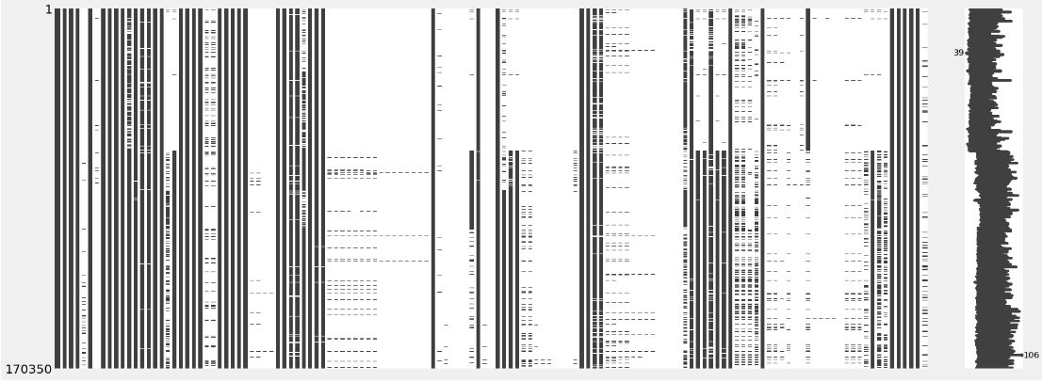
Data Cleaning
Matrix of missing values in the dataset:
29-05-2022
School of Advanced Sciences (S.A.S.)

Slide 8
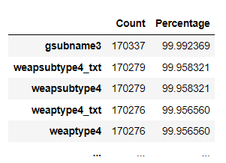
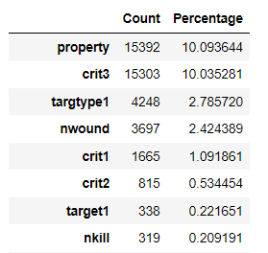
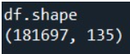
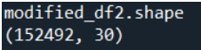
Data Cleaning
Strategies for treating missing values in entire dataset:
Column-wise: Drop columns with more than 15% missing values, compute out of total number of missing values in all observations, i.e., rows
Row-wise: Drop rows with more than 5% missing values, computed out of total number of missing values across all columns
29-05-2022
School of Advanced Sciences (S.A.S.)

Slide 9
Data Cleaning
Strategies for treating missing values in individual attributes:
If the categorical data is not skewed, impute with mean, mode or median
If the data is numerical and not significantly correlated with more than one variable, impute with standard deviation
29-05-2022
School of Advanced Sciences (S.A.S.)

Slide 10
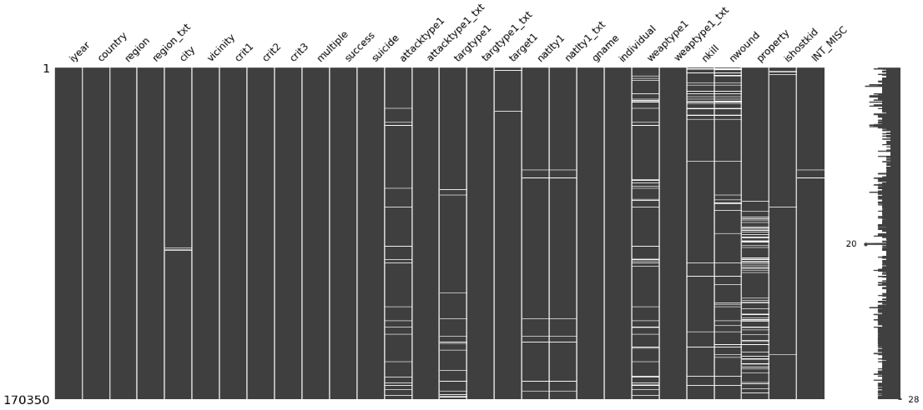
Data Cleaning
Post data cleaning we obtain the following dataset:

Slide 11
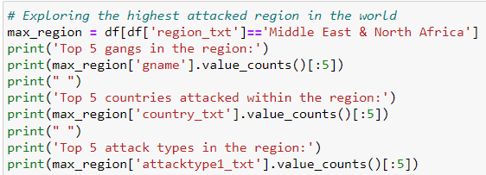
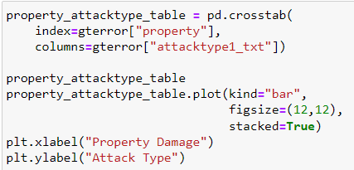
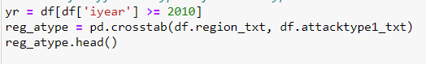
Data Visualization
Non-graphical Analysis
Use of pandas in-built functions like:
- shape | len | corr() | skew()
- value_counts() | pd.crosstab() | groupby()
Graphical Analysis
Use of various plots and charts available in pandas, matplotlib, seaborn and Plotly to explore attributes such as:
Attack Types | Weapon Types | Motive | Success
Country & Region | nkill & nwound
29-05-2022
School of Advanced Sciences (S.A.S.)

Slide 12
Region-wise
Attack-wise
Highest attacked region
- Most attacked country within
- Top 5 prominent gangs
- Top 5 prominent targets
Popular weapons with respect to
- Target
- Motive
Approach
Attack Types since 2010
Line Plot
Property damage since 2010
Bar Plot
Attack & weapon types with respect
to success
Count Plot
Property damage due to different attack and weapon types
Top 10 deadliest gangs over the years
Top 50 countries:
- Terror dominated
- Terror free
Gangs responsible for
the rise after 2010
Horizontal Bar Chart
Number of killed and wounded
Horizontal Bar Chart
Frequency of attacks over the years
Line plot | Count plot
Year-wise
29-05-2022
School of Advanced Sciences (S.A.S.)

Slide 13
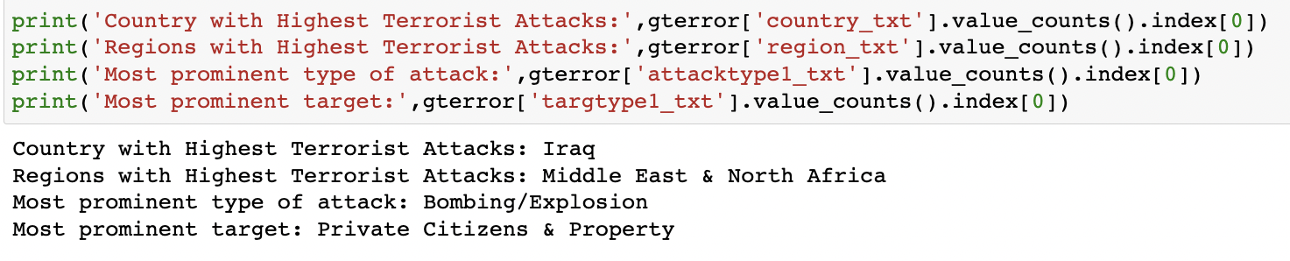
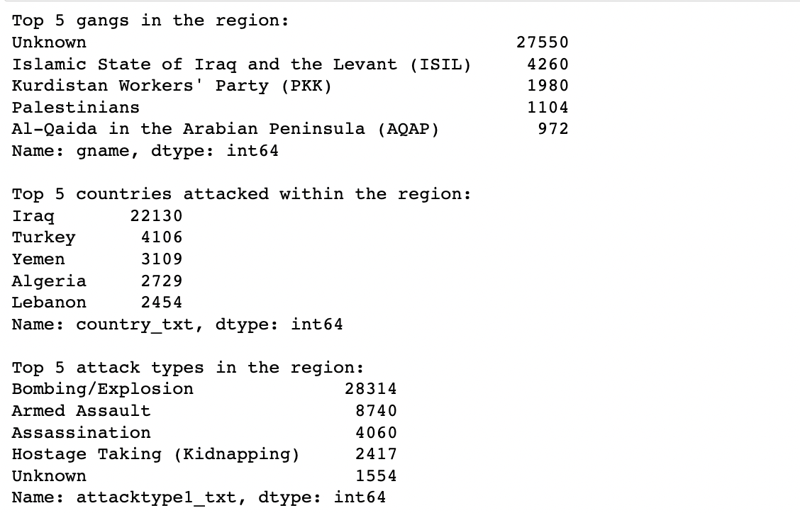
Results & Interpretation
29-05-2022
School of Advanced Sciences (S.A.S.)

Slide 14
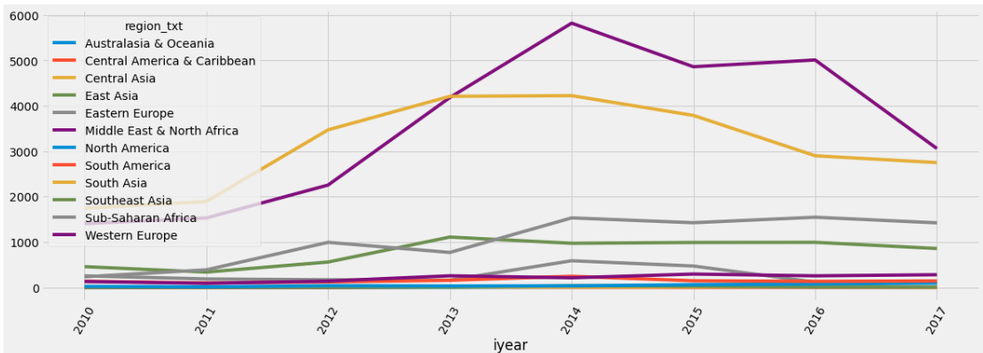
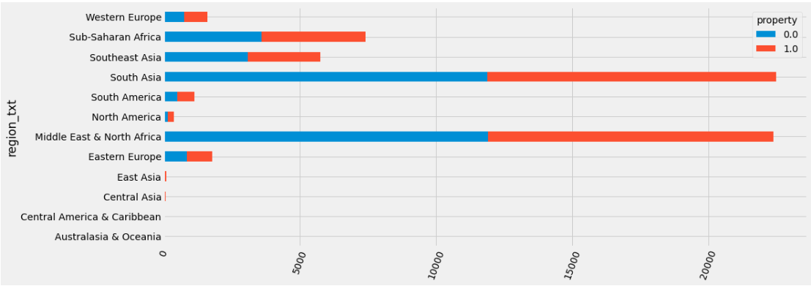
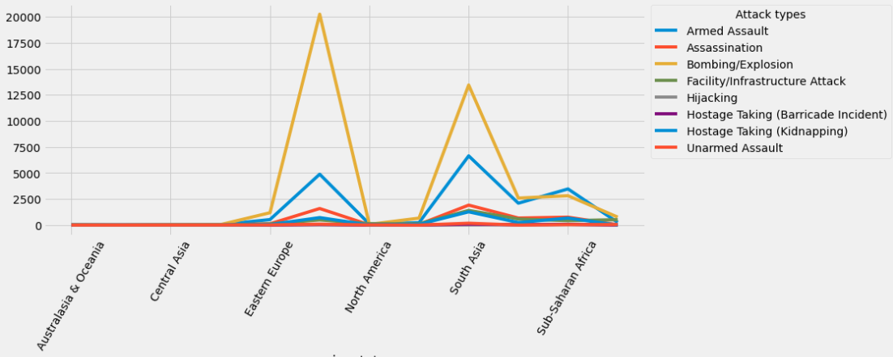
Results & Interpretation
Sharp rise in attacks in Middle East & North Africa and South Asia beyond 2010.
Approx. 55% attacks resulted in property damage in Middle East & North Africa and South Asia between 2011 and 2014.
Bombing/Explosion identified as most popular attack type in Eastern Europe and South Asia followed by Armed Assault.
29-05-2022
School of Advanced Sciences (S.A.S.)

Slide 15
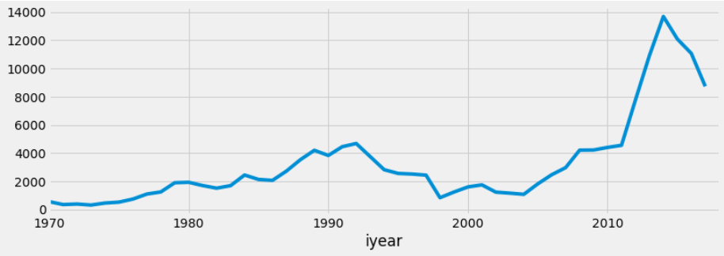
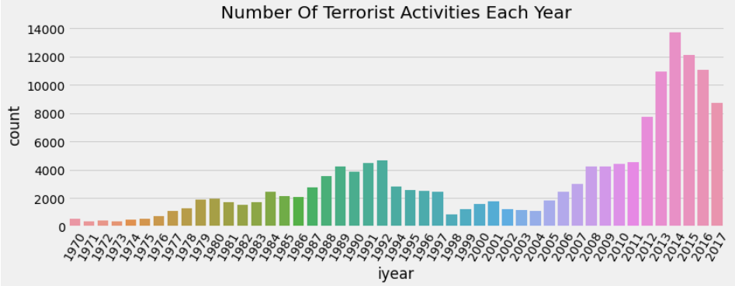
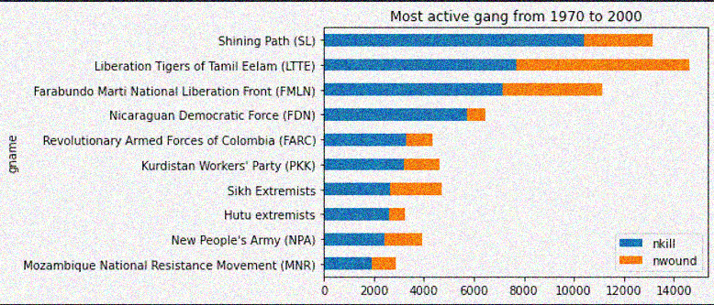
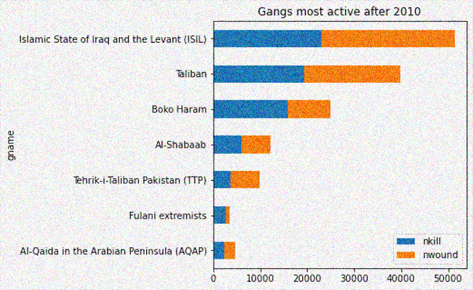
Results & Interpretation
Steady growth in terrorist activities till 2010 and then a steep rise beyond 2010 followed by a downfall.
The rise is significant from 2011 until the peak is reached in 2014, following which there is a steady decrease in attacks each year
SL and LTTE appear to be dominant with approx. 62% and 47% of the people affected being killed.
Previous set of groups are replaced by new groups such as ISIL and Taliban
29-05-2022
School of Advanced Sciences (S.A.S.)

Slide 16
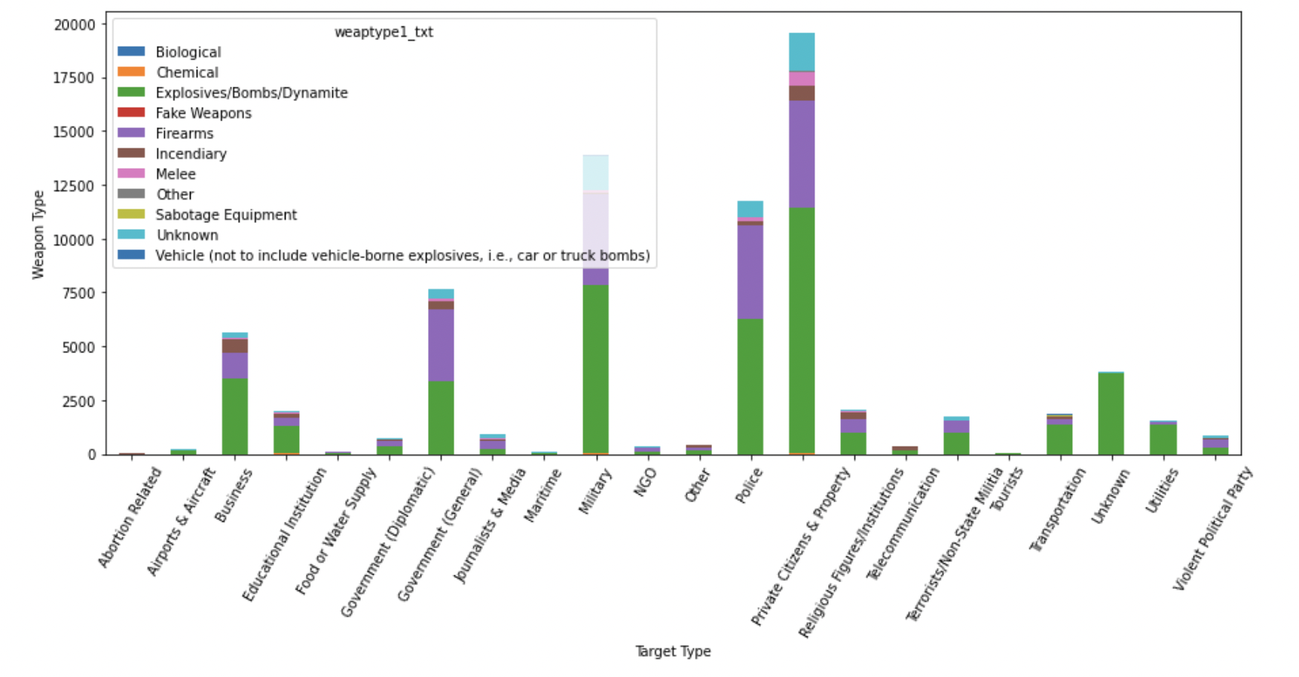
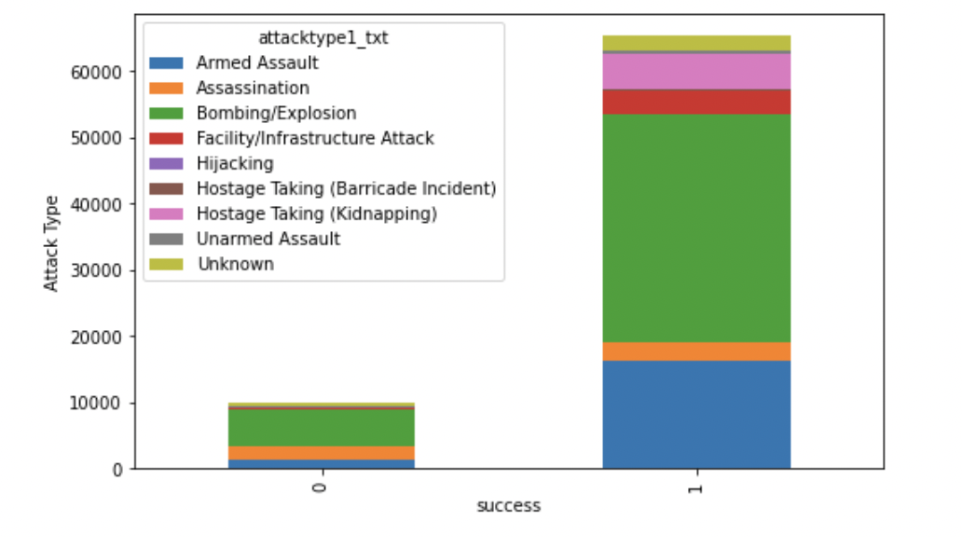
Results & Interpretation
The most attacked target type is "Private Citizens and property" followed by "Military“ while the most frequently used weapon is Explosives/Bombs/Dynamite and Firearms
In overall there is more successful attacks than failed attacks.However the Explosives/Bombs/Dynamite and Armed Assault turned out to be the most successful attack.
29-05-2022
School of Advanced Sciences (S.A.S.)

Slide 17
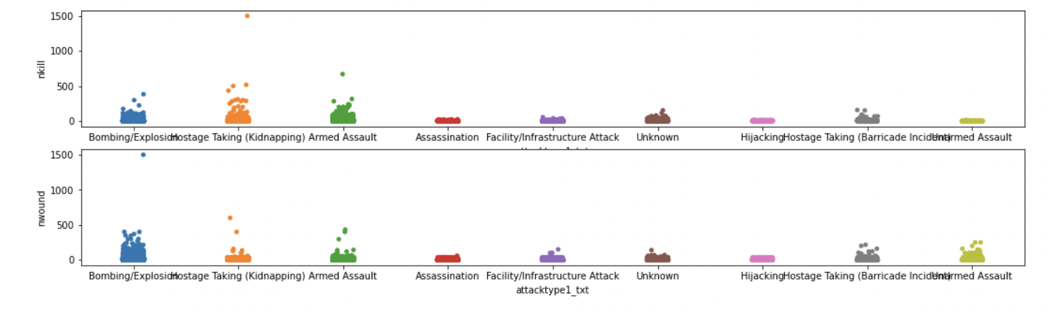
Results & Interpretation
- Hostage taking has the highest number of kills while more are wounded during hijacking.
- Most of the kinds of attacks have up to 1000 number of deaths and wounded respectively, very few have more than that number of kills
- Assassination does not target a large group hence it has lesser number of deaths
29-05-2022
School of Advanced Sciences (S.A.S.)

Slide 18
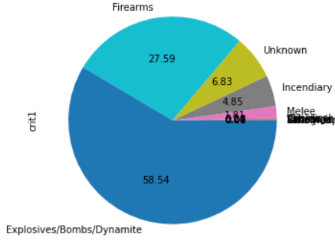
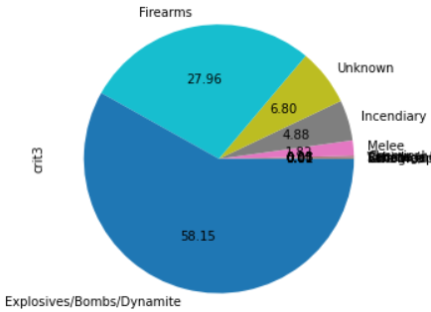

Results & Interpretation
We can clearly see that all the kinds of weapons are fulfilling every criterion in a similar manner. However, counts differ slightly.
Comparatively we can see that “Explosives” fulfil the criteria 1 (i.e., POLITICAL, ECONOMIC, RELIGIOUS, OR SOCIAL GOAL) the most.
- ”Firearms” fulfil criteria 3 (i.e., OUTSIDE INTERNATIONAL HUMANITARIAN LAW) the most
29-05-2022
School of Advanced Sciences (S.A.S.)

Slide 19
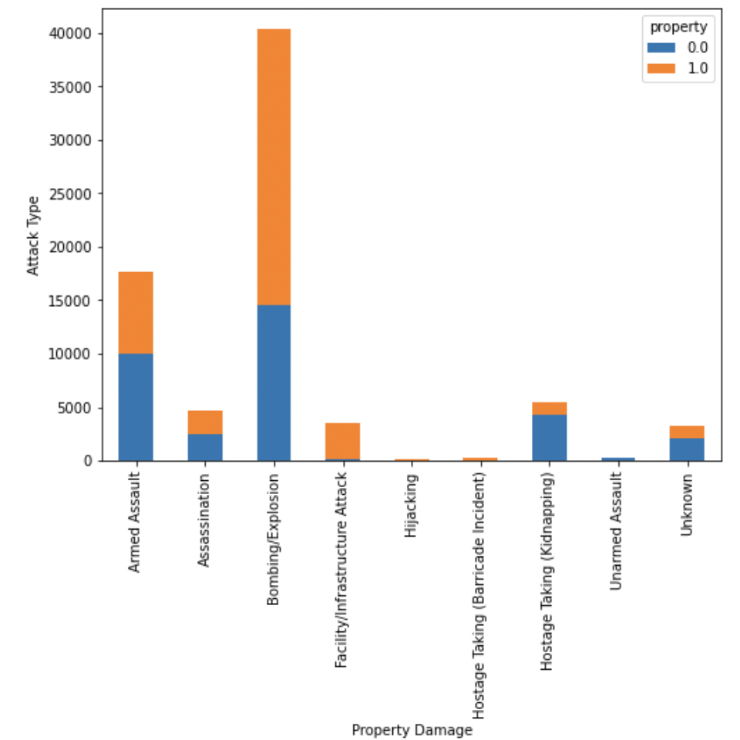
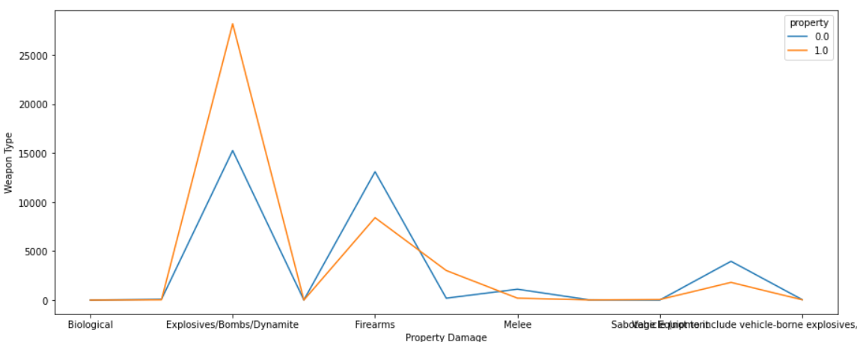
Results & Interpretation
Explosives damage the property the most
We come to realize that Bombing/Explosions cause significantly more property damage than other attacks. Of the total number of attacks that caused property damage since 1970, 57% attacks occurred in 2010 and beyond.
29-05-2022
School of Advanced Sciences (S.A.S.)

Slide 20
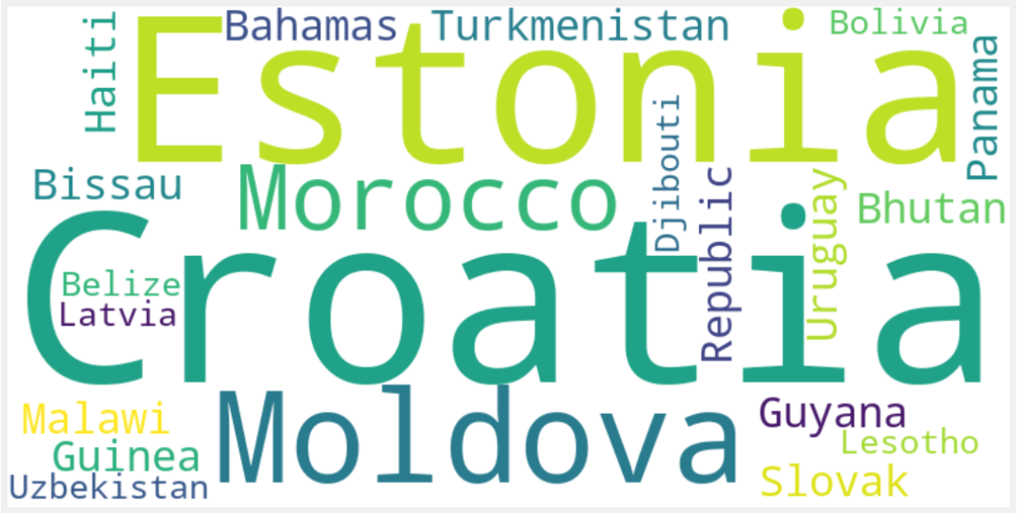
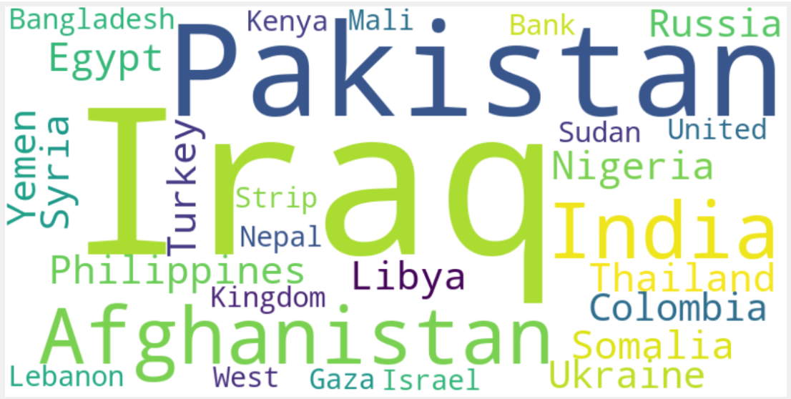
Results & Interpretation
Top 20 Countries with 2 or less terrorist activities since 2010
Top 25 Countries with terrorist activities between 384 and 17,420 since 2010
29-05-2022
School of Advanced Sciences (S.A.S.)

Slide 21
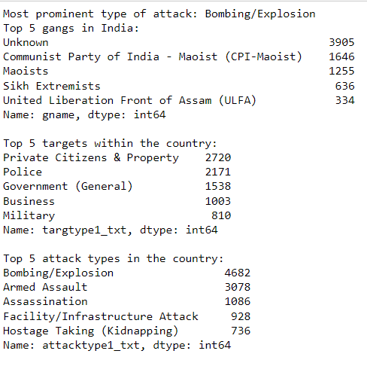
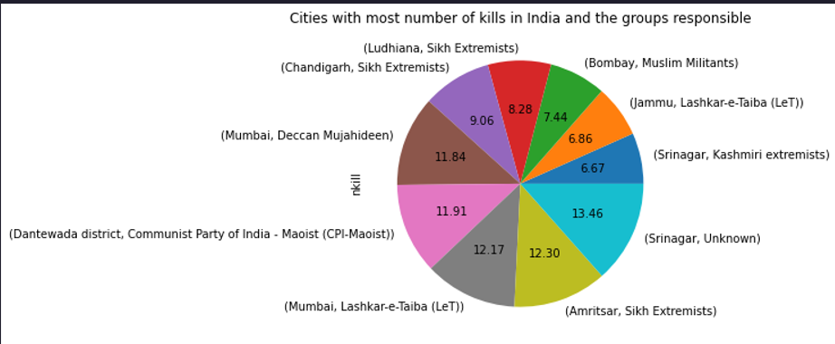
State of Terrorism in India
29-05-2022
School of Advanced Sciences (S.A.S.)

Slide 22
Technical Specification
Following tools are used in the analysis:
- Web application Jupyter Notebook and Spyder (IDE) for creation and storage of live codes
- An octa core processor for the magnitude of GTD
- Python and various libraries such as Pandas, Numpy, Matplotlib, Seaborn, Missingno, Plotly, and WordCloud.
29-05-2022
School of Advanced Sciences (S.A.S.)

Slide 23
Limitations
Following limitations were identified as the team progressed:
Lack of a suitable system processor
Magnitude & structure of dataset
Inadequate performance of web application for live coding
Lack of perception in strategizing the analysis
29-05-2022
School of Advanced Sciences (S.A.S.)

Slide 24
Conclusion
Regions Middle East & North Africa and South Asia have suffered brutally as a result increased bombings and explosions between 2010 and 2016.
Terrorist groups Islamic State of Iraq and the Levant (ISIL), Taliban, and Boko Haram have been identified as top 3 gangs responsible for majority of activities during this period.
While the countries like Estonia, Croatia, Morocco, Latvia have experienced not more than 2 activities, the state of terror remains of concern in Iraq, Pakistan, Afghanistan and India.
There is more way more successful attacks than failed attacks.If the attack is successful then “Hostage taking” has the highest number of kills while more are wounded during hijacking
We can see that mainly “Explosives” are used for “POLITICAL, ECONOMIC, RELIGIOUS, OR SOCIAL GOAL” the most.While ”Firearms” are mainly used for “OUTSIDE INTERNATIONAL HUMANITARIAN LAW”
29-05-2022
School of Advanced Sciences (S.A.S.)

Slide 25
References
Sahoo, K., Samal, A.K., Pramanik, J. and Pani, S.K., 2019. Exploratory data analysis using Python. International Journal of Innovative Technology and Exploring Engineering (IJITEE), 8(12), p.2019.
Stackoverflow (2022) All Questions. Available at: https://stackoverflow.com/questions (Accessed: 31 May, 2022)
Tripathi, A.K., Rathee, G. and Saini, H., 2019, November. Taxonomy of missing data along with their handling methods. In 2019 Fifth International Conference on Image Information Processing (ICIIP) (pp. 463-468). IEEE.
University of Marylan (2021) GTD CODEBOOK: METHODOLOGY, INCLUSION CRITERIA, AND VARIABLES. Available at: https://www.start.umd.edu/gtd/downloads/Codebook.pdf (Accessed: 31 May 2022).
29-05-2022
School of Advanced Sciences (S.A.S.)

